Slide 1

Algorithmic HFT
Quant Club White Paper
Aman Sharma

Slide 2

Table of Contents
Introduction to AT
Types of Algorithmic Trading
Use of algorithms in HFT
Strategies for Algorithmic HFT
Disadvantages and Roadblocks
Basic Implementation Details

Slide 3
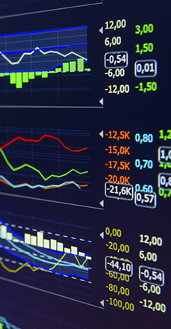
Algorithmic Trading
Automated trading, black-box or algo-trading
Algorithm being a set of pre-defined instructions that trade instead of humans
Can be based on timing, price, or any mathematical model.

Slide 4
Algorithmic Trading
A simple algorithm without use of predictive analysis-
Buy 50 shares of a stock when its 50-day moving average goes above the 200-day moving average.
Sell shares of the stock when its 50-day moving average goes below the 200-day moving average.

Slide 5
Algorithmic Trading
Algorithms can look at and analyze more data than humans at a much faster rate.
This makes them perfect to capitalize on miniscule arbitrage opportunities that arise.
They can look across multiple brokers for price differences or profit from price differentials between stock vs futures instruments.

Slide 6
Execution Algorithms
Situational Algorithms
Seek to reduce costs by executing bulk orders in small chunks
Algorithms that take trading decisions based on the current situation of the market
Aimed at reducing market impact and to save costs
Designed to replace humans as a more intelligent decision maker and aimed at making profits
Mainly used by mutual funds, investment banks, hedge funds, etc
Usually proprietary and designing a good situational algorithm is going to make you lots of money

Slide 7
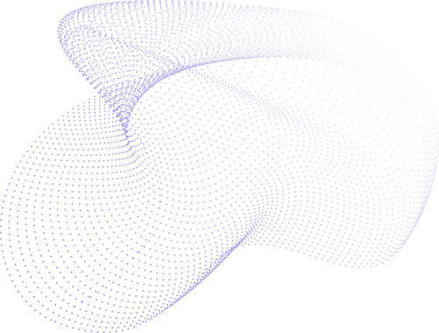
Why algorithms instead of humans?
Let us take an example of E-mini S&P 500 futures (ES) and
SPDR S&P 500 ETFs (SPY) at different time frequencies

Slide 8
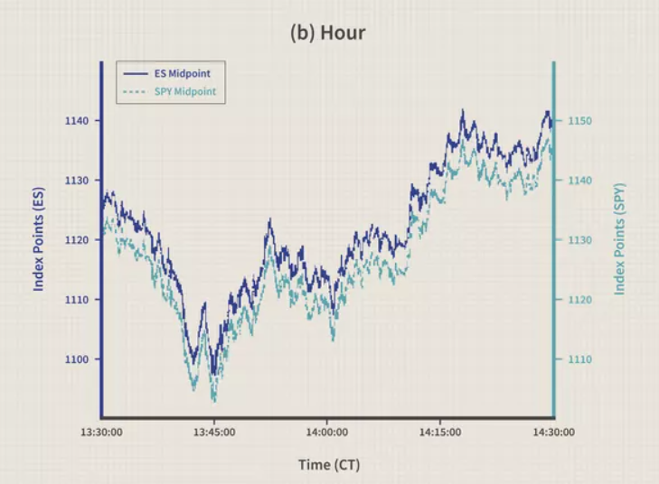
Source: investopedia

Slide 9
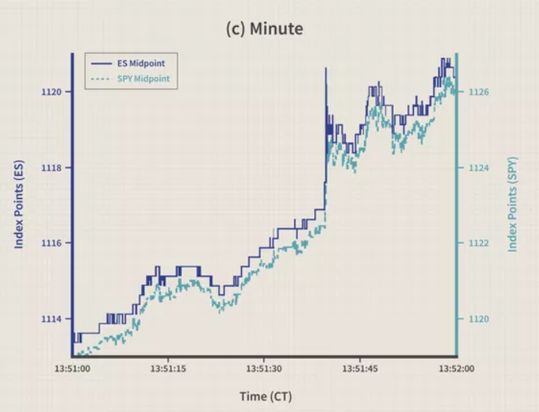
Source: investopedia

Slide 10
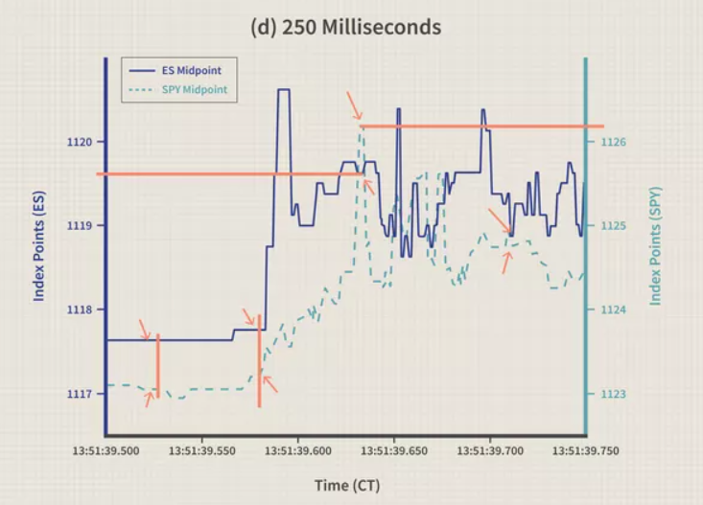
Source: investopedia

Slide 11
High Frequency Trading
These arbitrage opportunities only arise for milliseconds.
Their frequency is high.
Here comes in the idea of high frequency trading.
Trade frequently with a small profit each time.
Those profits all add up to make a good trading strategy.

Slide 12
The Benefits
of Algorithmic Trading using HFT

Slide 13

Can profit significantly even from small price changes: As in HFT the trades are being made frequently, if the correct trading opportunity arises, we can even make a profit from a small price fluctuation
Profit from more information than a human can process: Algorithmic HTF can capitalize on arbitrage opportunities between different trade markets which is virtually impossible for a human to continuously monitor
Higher liquidity in the market: Since the market makers are employing Algorithmic HFT as well, there is always someone to buy or sell at the current price which improves the market liquidity to a great deal

Slide 14
Strategies for Algorithmic HFT
These are the trading strategies you can base your algorithms upon and features that it can have

Slide 15
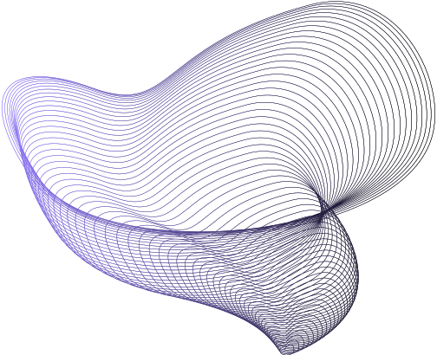
Trend-following Strategies
These strategies come down to automating technical analysis.
Instead of using indicators to predict the pricing, we can program algorithms to do so.
We do not need to make complex predictions and instead just need to initiate trade based on simple indicators like moving averages.
The example of 50 and 200 day moving average is a trend following strategy.

Slide 16
Capitalise on Arbitrage
Due to certain market conditions, arbitrage opportunities exist which fast and precise algorithms can capitalise on.
This can be as simple as buying and selling a stock that is listed on two exchanges at slightly different prices, or as complex as taking advantage of price differentials between pairs or stocks and their respective futures.
These algorithms need to be blazing fast as these arbitrage opportunities exist for only a small period of time.
Execution of such algorithms needs data streams at extremely low latencies.

Slide 17
Trading Range(Mean Reversion)
Based on assumption that stocks maintain a mean price and fluctuate in a range around it.
Trades can be automatically triggered when price goes out of this range.
Implementation Shortfall
Occurs when the price changes between order placement and execution.
Can be decreased with faster algorithms that place limit orders on current prices.

Slide 18
Volume Weighted Avg. Price(VWAP)
Break up a large order and execute it in small volumes based on historical volume profiles.
Aim is to execute the order close to VWAP.
Time Weighted Avg. Price
Executes a large order at equal intervals of time.
Aim is to execute the order close to the TWAP.

Slide 19
Mathematical Model Based Strategies
Strategies based on proven mathematical models can be effectively employed using algorithms.
One such strategy is the delta-neutral trading strategy.
It allows trading on the basis of delta ratios which compare the change in price of an asset to the corresponding change in the underlying asset.
An algorithm can effectively analyse the past volatility data and tell us whether employing such a strategy would be beneficial.
Another mathematical strategy is the martingale strategy.

Slide 20
Deep Neural Networks
As we know that price relationships in certain situations can be modelled mathematically.
Deep neural networks are capable of learning complex non-linear relationships that might not even exist from the point of view of a human.
These can then be used to forecast the prices and can then be traded accordingly.
The deeper the neural network, the better it might be able to understand the relationship but too much training on the data can resulting in it picking up the noise at which point the predictions become worthless.

Slide 21
Sentiment Analysis
As we know there are a lot of current securities (aka crypto) that don’t have any fundamentals to go off of.
Other than expandability of the currency and other such factors, in the short term the dependency of such securities is correlated higher to market sentiment than traditional stocks.
In such scenarios, sentiment analysis which is a well known NLP problem can be used to aid decision making.
There exist live data feeds of bitcoin sentiment from the likes of Thomson Reuters which analyses market sentiment from a variety of social media platforms and news sites.

Slide 22
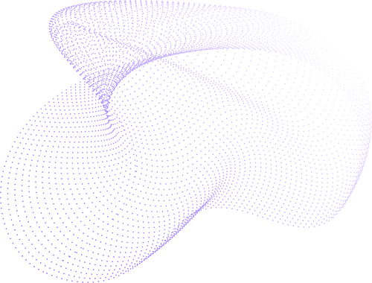
Disadvantages and Roadblocks
High cost of entry
HFT requires you to be close to the origin of the data feed so there is less delay as even milliseconds of delay can lead to loss of many arbitrage opportunities to people who have better facilities. Thus, you need a good location and extremely fast and powerful computers.
More data translates to more profit
There are tiers of live data feeds, the higher tiers being more expensive to setup but also providing with more information about the current market trade. This means you will need to pay more to have more information to retain your competitive advantage.
In a competitive market, if you can think of something, others can some up with something similar.
Simple glitches mean disaster
Since trades that are profitable are executed super fast, in case of an anomaly, a wrong trade will be executed in bulk with speed as well and the losses can skyrocket very fast. One such example is of Knight Capital which due to faulty software lost 40% of the company value in a single day after sustaining losses of $440 million.

Slide 23
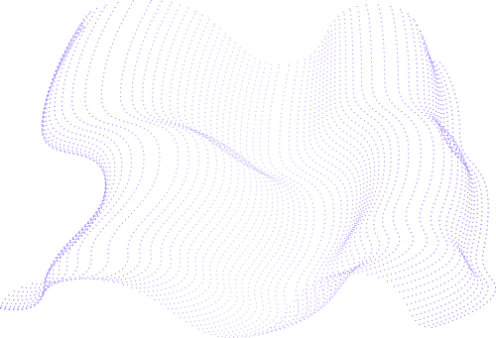
Looking at some basic implementation of a simple algorithm now
Link to sma implementation- https://github.com/AmanSharma0710/Quant-Club-Whitepaper/blob/main/moving_avg.ipynb
Link to implementation of LSTM for stock prediction- https://towardsdatascience.com/getting-rich-quick-with-machine-learning-and-stock-market-predictions-696802da94fe

Slide 24
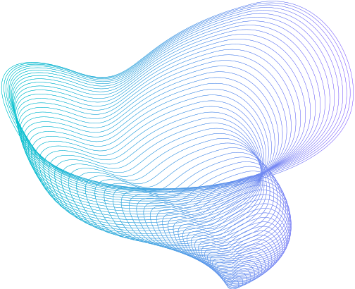
Do you have
any questions?

Slide 25
Thank You.

